Slide 1
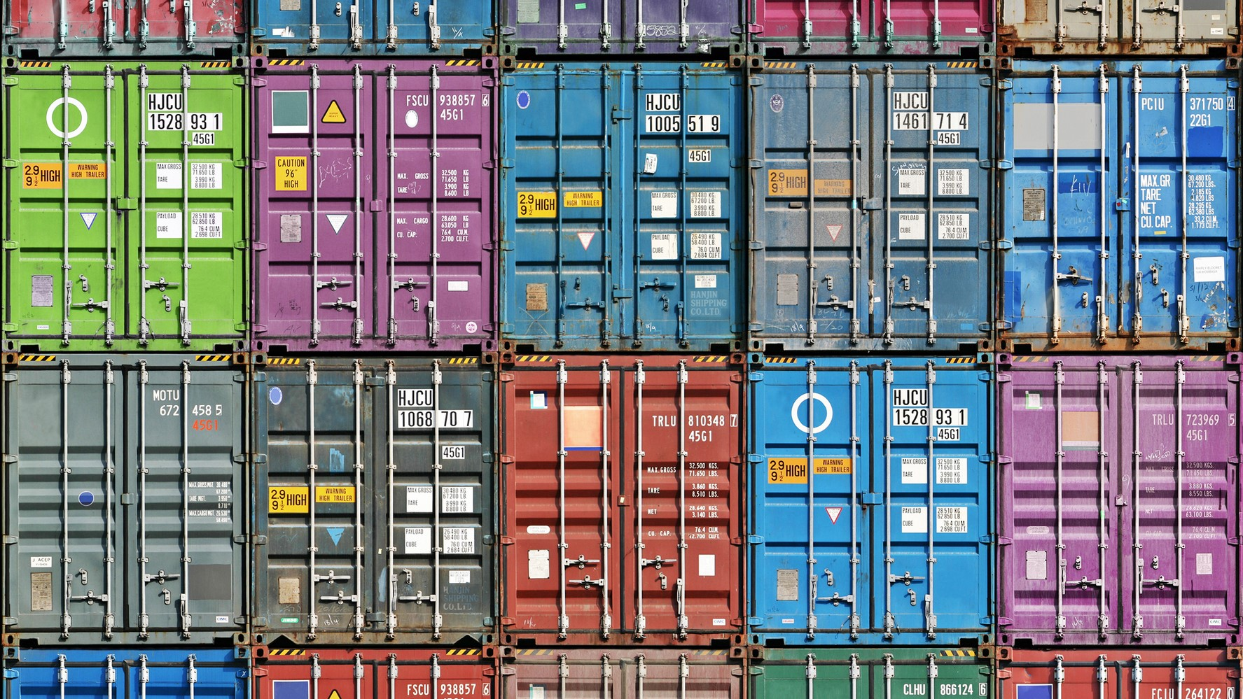
Docker Containers
Presentation by Marius Asadauskas & Julius Oeftiger
Fabrication and Prototyping in the Learning Lab
10.11.2022
Notes:
[image]: https://atlas-network.com/wp-content/uploads/2019/03/containers1-16.9.jpg

Slide 2
Timeline
Docker Basics
Docker Security
Pi-hole

Slide 3
All problems in computer science can be solved by another level of indirection.
David Wheeler

Slide 4
I get different results
It works on my machine but not yours!
How to scale
How to reduce IT costs
How to manage Dependencies

Slide 5
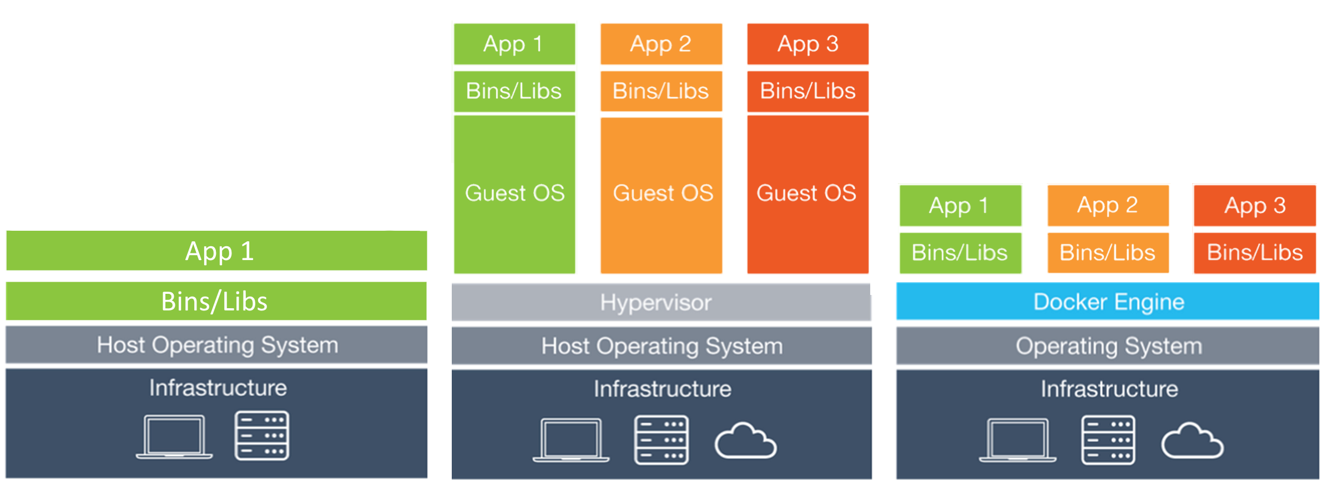
OS, Virtual Machines and Docker
Notes:
[Image]: https://stalk-calvin.github.io/img/20170415vd/docker.png

Slide 6
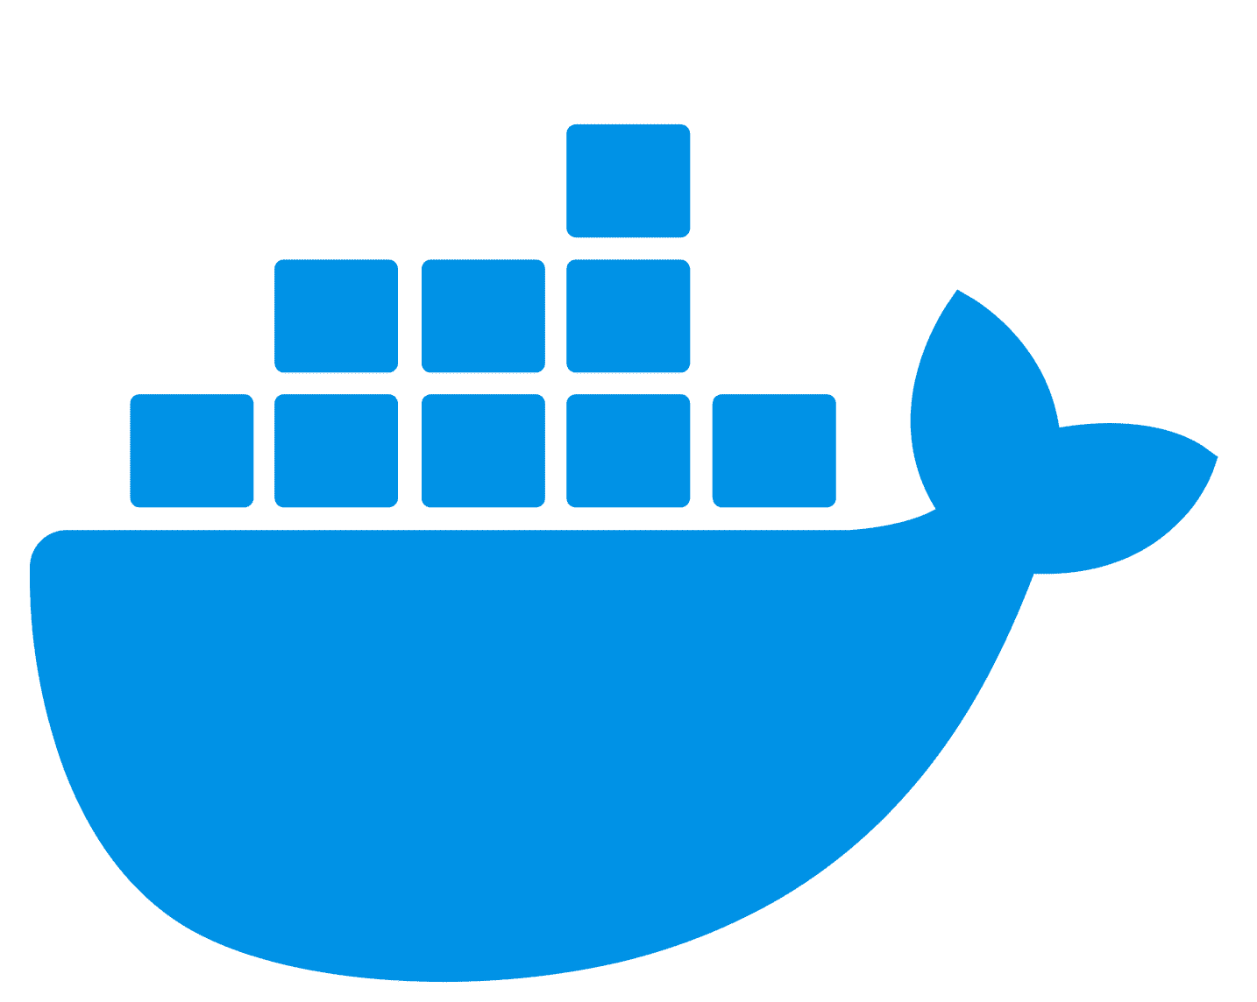
Docker Containers
Pros:
Cons:
Lightweight
Highly Portable
Efficient
Quick Boot Up
Not fully Open Source
Slight Overhead
Persistent Storage
Persistent daemon running as superuser
Many containers require root
Notes:
[Logo]: https://logos-world.net/wp-content/uploads/2021/02/Docker-Logo.png

Slide 7
Alternatives
Podman (podman.io)
Singularity (sylabs.io)
Many more
Notes:
Docker encourages many micro-serviced containers for interleaving them
Singularity uses monolithic, image-based approach

Slide 8

Docker Security Aspects
Security of kernel, namespaces, and cgroups
Attack surface of Docker
Loopholes in the container
“Hardening” security features
Notes:
[Aspects]: https://docs.docker.com/engine/security/

Slide 9
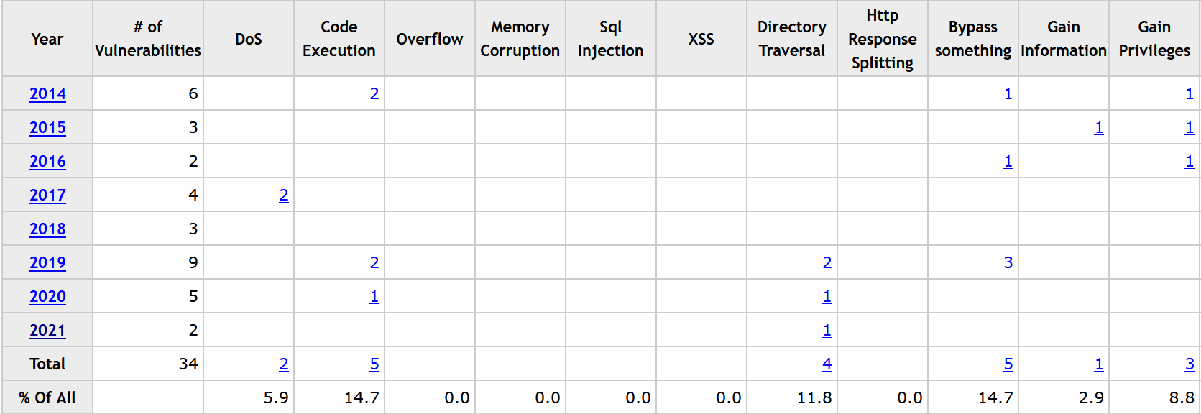
Docker Attack Surface
Notes:
[Data]: https://www.cvedetails.com/product/28125/Docker-Docker.html?vendor_id=13534

Slide 10
Image Security ~Beginning
Over 30% of official images included high priority vulnerabilities [1]
300’000 images had on avg. 180 vulnerabilities [2]
Many images not updated for 100+ days [2]
Vulnerabilities usually spread from parent to child [2]
Notes:
[1]: J. Gummaraju, T. Desikan, and Y. Turner. Over 30% of official images in docker hub contain high priority security vulnerabilities. Technical report, BanyanOps, 2015
[2]: Rui Shu, Xiaohui Gu, and William Enck. 2017. A Study of Security Vulnerabilities on Docker Hub. In Proceedings of the Seventh ACM on Conference on Data and Application Security and Privacy (CODASPY '17). Association for Computing Machinery, New York, NY, USA, 269–280. https://doi.org/10.1145/3029806.3029832

Slide 11
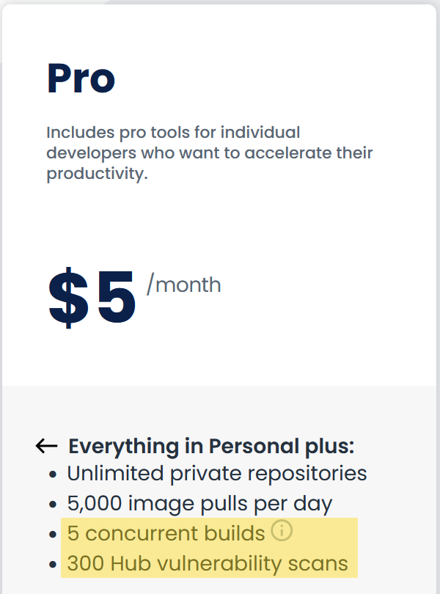

Security Nowadays
Database of vulnerabilities
Scans layer by layer for flaws
Continuous monitoring of vulnerabilities
Notes:
[Clair]: https://github.com/quay/clair, https://github.com/arminc/clair-scanner
[Docker Pro]: https://www.docker.com/pricing/

Slide 12


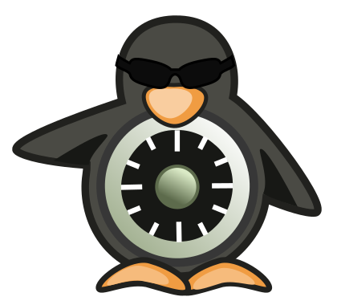
Hardening
Leverage existing, well-known systems
Restrict programs capabilities with AppArmor
(MAC) Mandatory Access Control with Tomoyo
Security Enhanced Linux (SELinux)
Notes:
[AppArmor]: https://en.wikipedia.org/wiki/AppArmor
[Tomoyo]: https://en.wikipedia.org/wiki/Tomoyo_Linux
[SELinux]: https://en.wikipedia.org/wiki/Security-Enhanced_Linux

Slide 13

Project: Pi-hole
DNS sinkhole
blocks ads, trackers (or whatever domain name you want)
one authority
works for all devices in network
can work as DHCP

Slide 14
Project: Pi-hole
Setup
https://github.com/pi-hole/pi-hole (manual setup)
https://github.com/pi-hole/docker-pi-hole/
https://hub.docker.com/r/pihole/pihole/
$ docker-compose up -d

Slide 15
Project: Pi-hole
Preconfigured RPi image
drive.google.com/file/d/1GZQBOYtnCTuL6GZ7jkmDVAAeMVF5QSmh
(WiFi AP not working due to DHCP issues)
host $ ssh dietpi@IP # pw = dietpi
dietpi $ cd Pi-hole/
dietpi $ docker-compose -d up

Slide 16

Project: Pi-hole
Performance (untuned, conservative adlists)
adblock-tester.com
BUT: DNS level ≠ Browser level

Slide 17
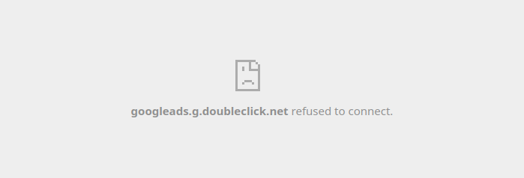
￼
Project: Pi-hole
Performance (untuned, conservative adlists)
adblock-tester.com

Slide 18
Thank you for Listening
Any questions?

